Slide 1
Embedded Valve and Actuator Sensors:
Bray Team Elevator Pitch
Avery Haynes, Locke Lehmann, Travis Carlson, Cody Sims, Zachary Walker, Michael Hager
11/27/2023
Notes:
Cody

Slide 2
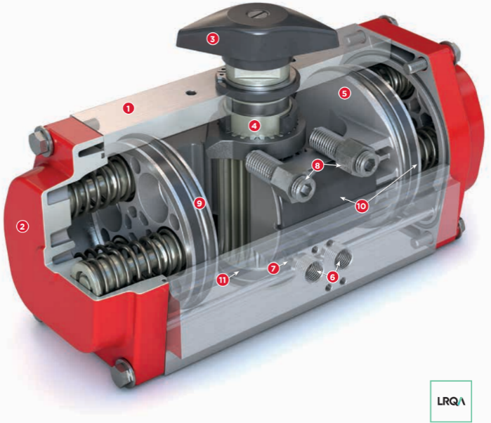
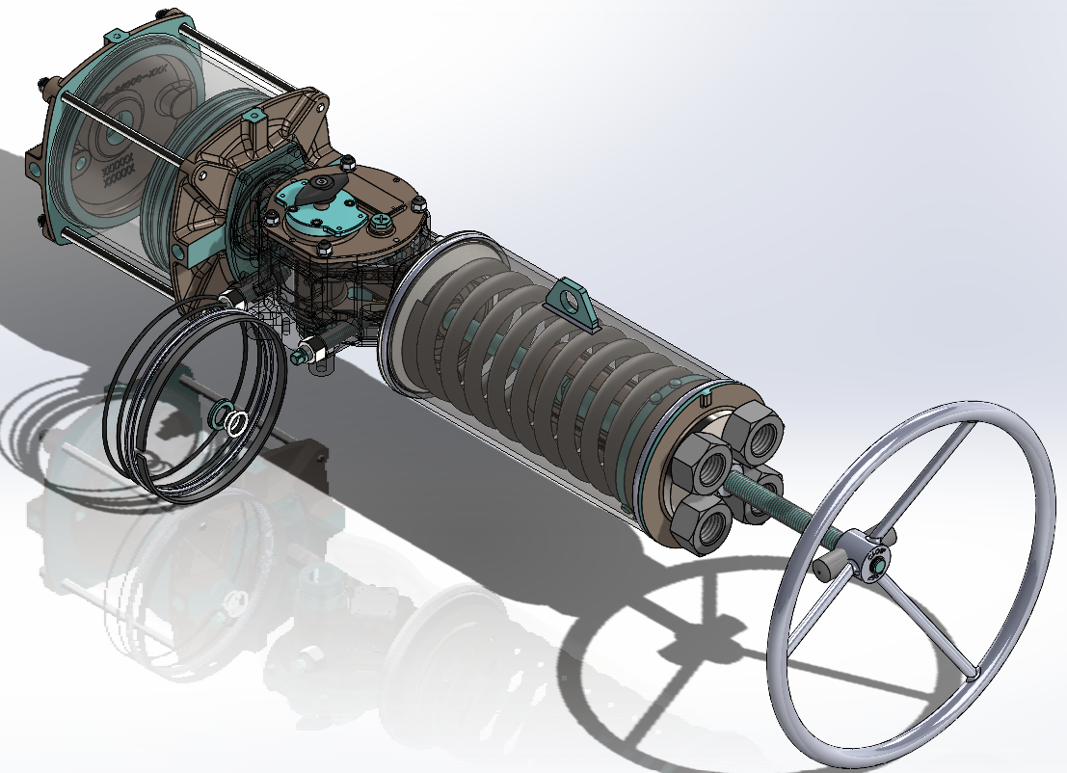
Problem Statement
Develop a method to internally measure valve position independent of an actuator and measure actuator output torque to increase the service life of the valve.
Notes:
Zack

Slide 3

Value Proposition
Understanding actuator performance improves service life
Creating a “smart” sensor system that can report output torque of an actuator and valve position in service will decrease downtime and maintenance costs
Accurately sense actuator-valve system properties
Embedded product ready for service deployment
Easy to understand data for the customer
Notes:
Avery

Slide 4
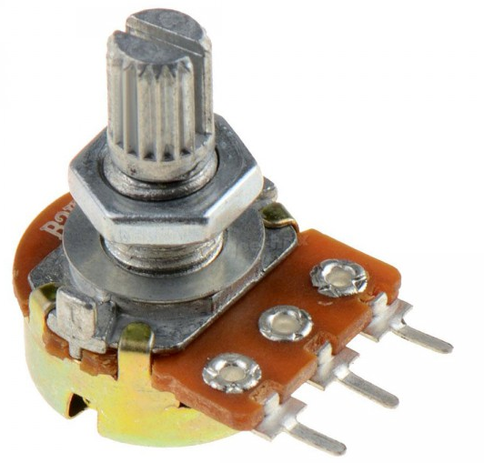
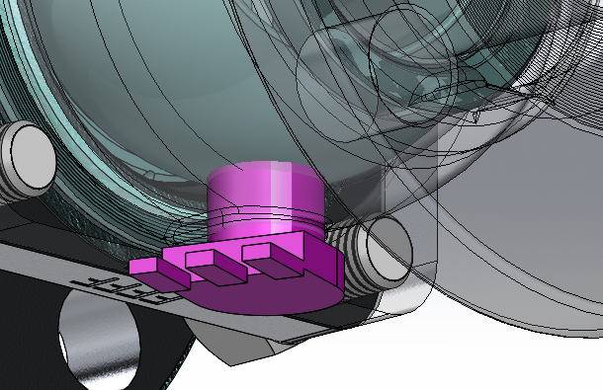
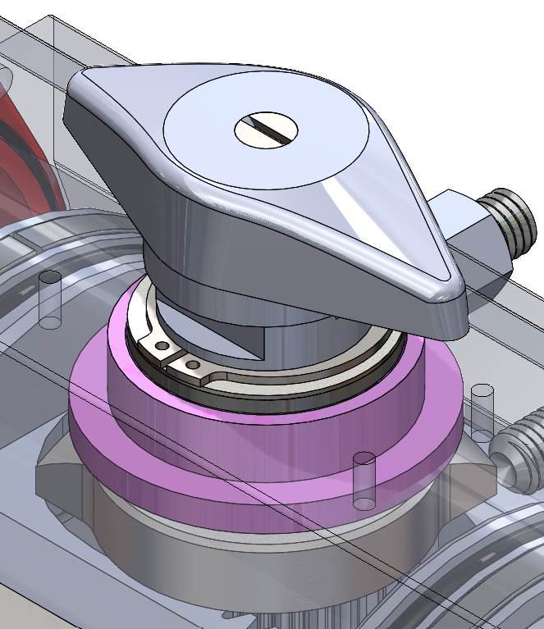
Underlying “Magic”
Potentiometers correspond voltage to position - calculate torque with inertia and position from voltage
Small, inexpensive, long-lasting
Live updates to computer readout
Notes:
Travis

Slide 5
Current Status
Determined sensors to measure output torque and valve positions
Constructed budget plan
Received from Bray a ball valve, butterfly valve, and rack and pinion pneumatic actuator for testing
Notes:
Michael

Slide 6
Future Work
Build testing rig that supplies correct pressure to turn the actuator
Wire DAQ to position and torque sensors
Determine factor of conversion from resistance to degrees of rotation
Validate accuracy of less than 5% can be achieved for all designs
Lifetime test the accuracy of each sensor configuration over millions of cycles
Seal the bottom of the valve to meet API 598 standards
Notes:
Locke

